Slide 1

Meadowcroft Primary school
Welcome to Fox class

Slide 2
Welcome Parents!
Meet the team:
Miss Deen - Class Teacher (Mon-Thurs)
Mrs Foster – Class Teacher (Friday)
Miss Bridges, Mrs Raven – Support staff

Slide 3
A day in Fox Class
Doors open - 8.30am
Registration - 8.45am
Assembly – 8:50am
Morning session with a break for 15 minutes
  Phonics, English, Handwriting and Maths
Lunch-11.45pm
  Followed by playtime
Afternoon session-12.45pm
  Guided Reading and Foundation subjects
Home time - 3.15 pm
Breakfast club and after school club are available – these need to be booked in advance.

Slide 4

Intervention Groups
Over and above the work done in class it may be felt that your child will benefit from extra support with their learning.
Intervention groups will vary in size and will concentrate on different aspects of work.
The most likely are handwriting, maths, reading or writing.
These groups are popular with the children as they feel special and are able to take part in practical activities.
If we are concerned about your child’s progress, we will speak to you and of course you can approach us if you have any concerns.

Slide 5

Reading
Please encourage reading as often as possible. Children are encouraged to read at least four times weekly. Reading regularly will enable their fluency and comprehension to develop further.
We will be sending reading records home reading, Please write a very short comment or add a signature so we know your child has read.
Books will be sent out changed every Monday and Friday. Reading records and books should be in school everyday.

Slide 6

Physical Education
Lessons will be on Wednesday and Thursday for Fox Class.
No jewellery. Earrings and ear piercing restrict P.E lessons and will affect your child’s playtime activities too.
Children need to arrive to school wearing their PE clothes on Wednesday and Thursday.

Slide 7

Homework
In fox class we begin setting homework. These are tasks based on our learning in class.
Next week, each child will receive a homework book. Please make sure that their name is visible and clear on the front of the book.
Homework will be set half termly and will be shared in class for everyone to enjoy. This is an opportunity to celebrate the work that the children produce. The ‘best’ pieces may even be sent to Mrs Underwood for extra recognition of their hard work.

Slide 8
Please also send your child in with a (clearly named) coat, we go outside in all weather
Please don't put water bottles inside book bags with books - they all leak eventually and damage the books.
Please put your child's name clearly on everything especially water bottles, coats and jumpers/cardigans.

Slide 9
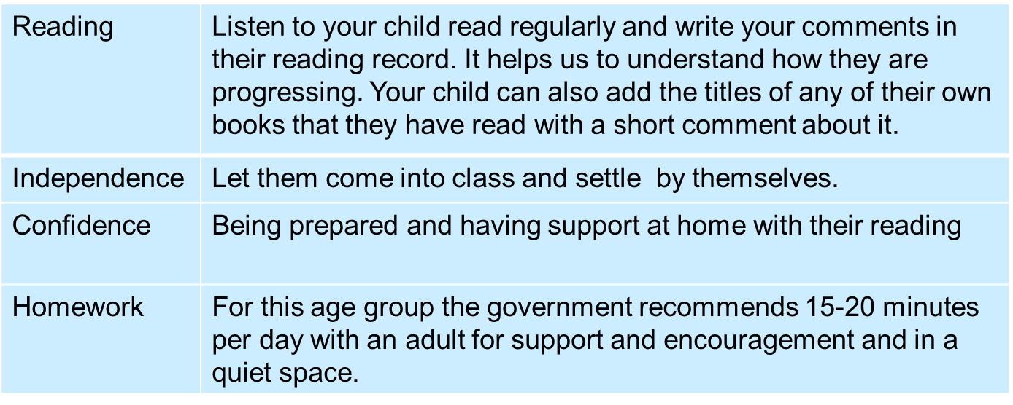
Helping your child: A summary
Named water bottle, named coat and named jumper/cardigan

Slide 10
Thank you!

